Slide 1
English Class #2
November 16, 2020

Slide 2
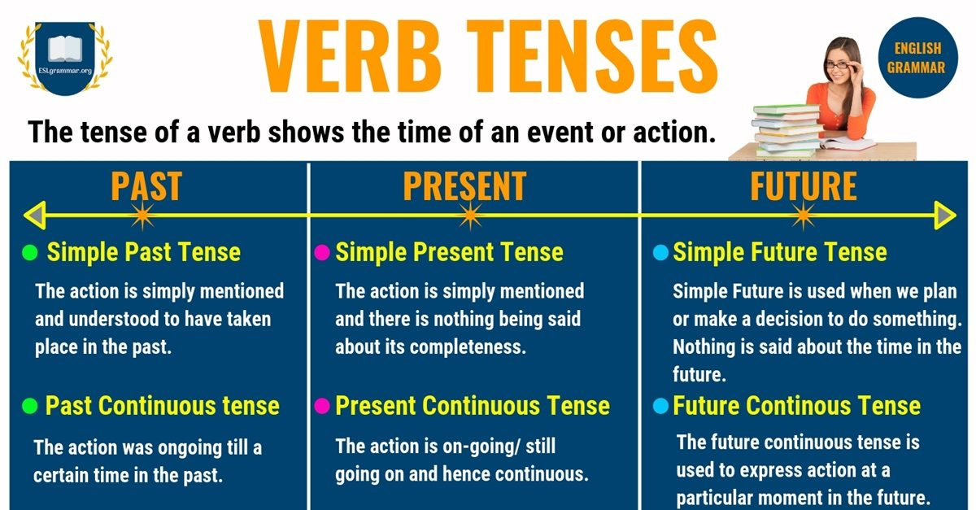

Slide 3
Verb Tenses:
Present:
He is driving the car
He has work today
She is a teacher
Past:
He was driving the car
He had work yesterday
She was a teacher
Future:
He will be driving the car OR He will drive the car
He will have work tomorrow OR He has work tomorrow
She will be a teacher

Slide 4
Rules For Subject Verb Agreement:
If the subject is plural the verb must be plural
If the subject is singular the verb must be singular
If you have two subjects “Dani and Arthur” then you use a plural verb
If there’s a phrase between the subject and verb you still match the first subject
If you are using the word “or” the verb is still singular
Words like “everybody” “anyone” or “each” are all singular

Slide 5
Subject Verb Agreement:
The books are on the desk
The book is on the desk
My sister is coming today
My sisters are coming today
There are three cookies
Here is the cookie
She writes every day
They write every day
The student, as well as the teacher, is excited
The teacher or the student is angry
Everybody is hungry

Slide 6
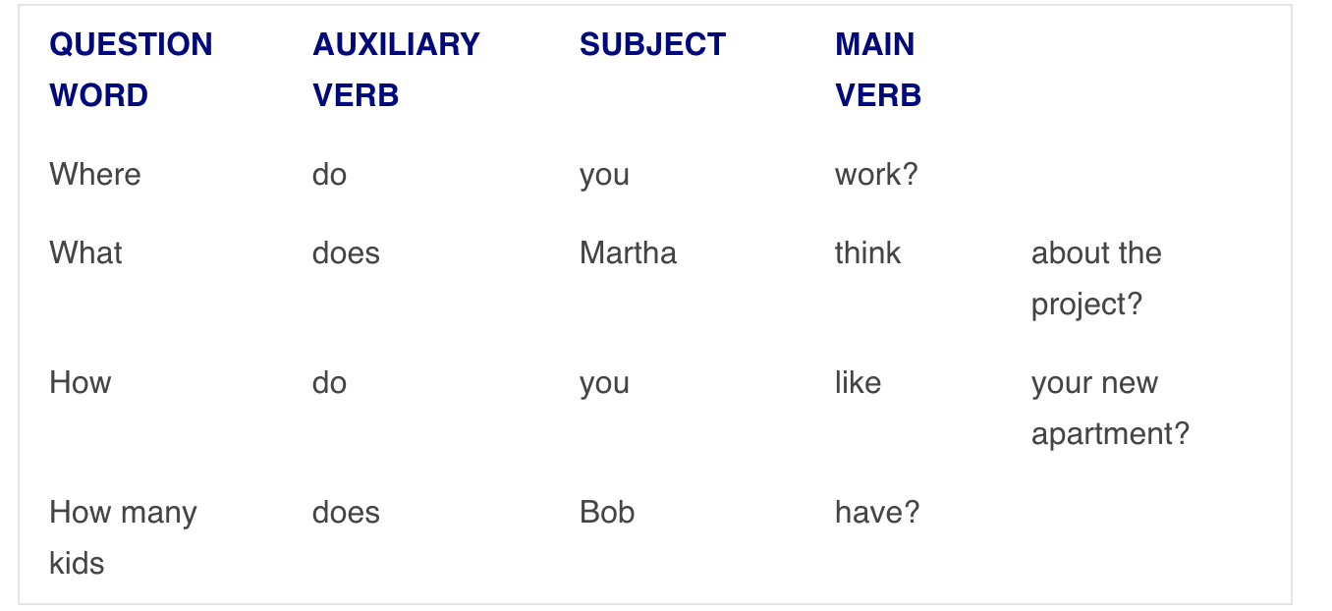
Formulating Questions: Present

Slide 7
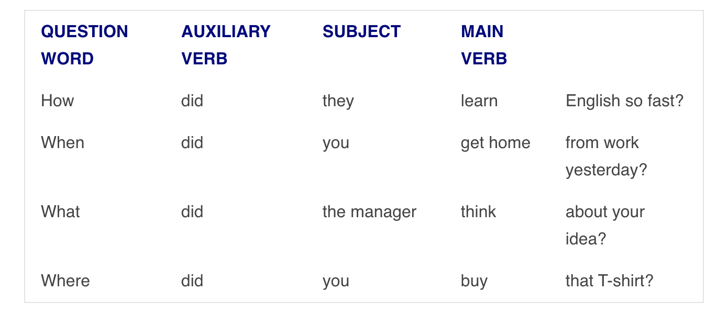
Formulating Questions: Past

Slide 8
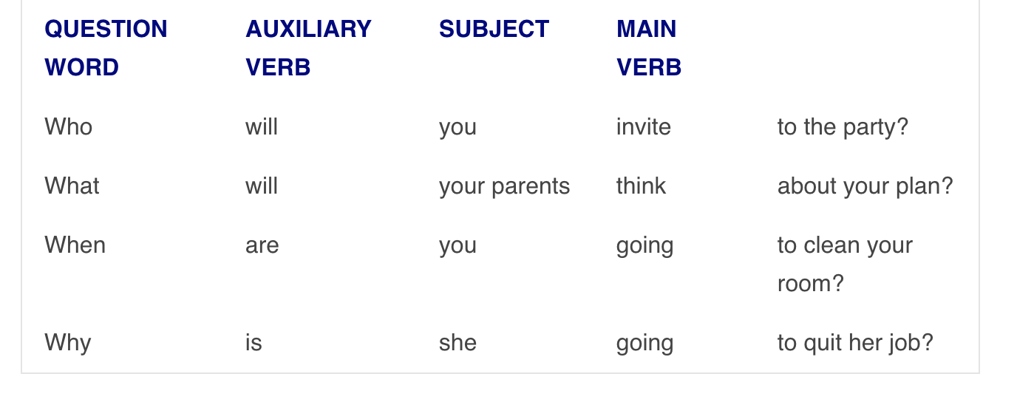
Formulating Questions: Future

Slide 9
Practice:
Let’s brainstorm some questions to ask each, and answer using subject verb agreement!
Examples:
What did you eat for breakfast today?
What will you do after this?

Slide 10
For Next Week:
Keep practicing the subject verb agreement in your daily conversations

